Slide 1










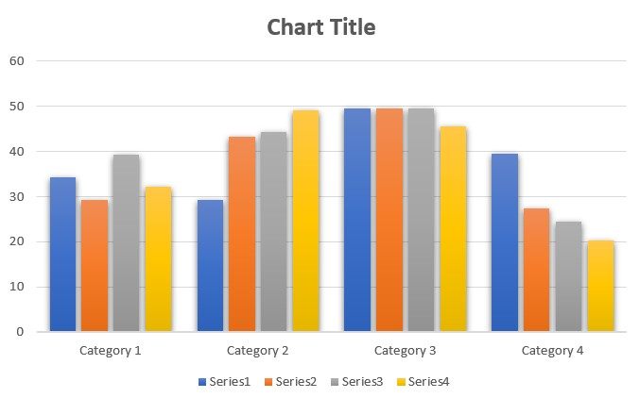
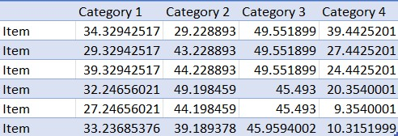
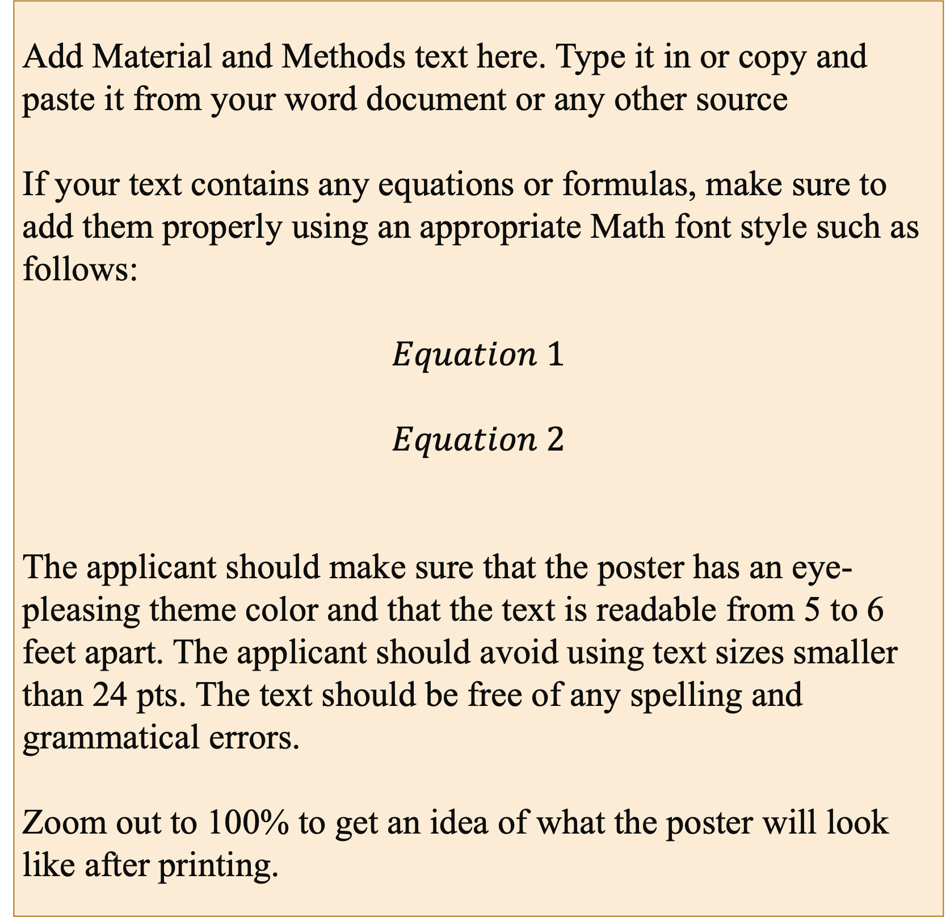
RSGCC-2023 (13 – 15 March 2023)
International Conference on Remote Sensing, GIS & Climate Change
RSGCRL (NCGSA), Centre for Remote Sensing, University of the Punjab, Lahore, Pakistan.
Poster Title for RSGCC-2023
Replace this text with your Title
Author Name¹, *Author Name^{1,2}, Author Name³, Author Name^{1,3}, Author Name^{2,3}
¹ Remote Sensing, GIS and Climatic Research Lab (NCGSA), University of the Punjab, Lahore (*Email: example@email.com)
² Centre for Remote Sensing, University of the Punjab, Lahore
³ Department of Space Science, University of the Punjab, Lahore
Logos of Authors’ institutions
Logos of Authors’ institutions
Abstract
Material and Methods
Results and Discussions
Add your abstract text here.
The placement of the headings (Introduction, Material and Methods, and Results and Discussions) can be changed according to how the applicant sees fit.
The applicant may change the poster's font style, size, and theme. However, the top ribbon (RSGCC-2023) must not be modified, but the placement can be changed (placed at the bottom or top of the poster as per the applicant’s desire).
This poster will be printed in A0 size so the applicant should ensure that the poster has an eye-pleasing theme color and that the text is readable from 5 to 6 feet. The applicant should avoid using text sizes smaller than 24 pts. The text should be free of any spelling and grammatical errors.
Zoom out to 100% to get an idea of what the poster will look like after printing.
Add Material and Methods text here. Type it in or copy and paste it from your word document or any other source
If your text contains any equations or formulas, make sure to add them properly using an appropriate Math font style such as follows:
$$Equation 1$$
$$Equation 2$$
The applicant should make sure that the poster has an eye-pleasing theme color and that the text is readable from 5 to 6 feet apart. The applicant should avoid using text sizes smaller than 24 pts. The text should be free of any spelling and grammatical errors.
Zoom out to 100% to get an idea of what the poster will look like after printing.
Add your Results and Discussions text here.
The placement of the headings (Introduction, Material and Methods, and Results and Discussions) can be changed according to how the applicant sees fit. However, no heading should be avoided and properly filled.
The applicant may change the poster's font style, size, and theme. However, the top ribbon (RSGCC-2023) must not be modified, but the placement can be changed (placed at the bottom or top of the poster as per the applicant’s desire).
This poster will be printed in A0 size so the applicant should ensure that the poster has an eye-pleasing theme color and that the text is readable from 5 to 6 feet. The applicant should avoid using text sizes smaller than 24 pts. The text should be free of any spelling and grammatical errors.
In the case of adding charts, graphs, and tables, the applicant should make sure to use an image instead of the actual graph/table. The image should not be stretched and should properly be added by using the ‘Picture’ tool in the ‘Shape Fill’ drop-down of the ‘Shape Format’ toolbar.
Zoom out to 100% to get an idea of what the poster will look like after printing.
Introduction
Add a relevant high-resolution image here
Add a relevant high-resolution image here
Add your abstract text here.
The placement of the headings (Introduction, Material and Methods, and Results and Discussions) can be changed according to how the applicant sees fit. However, no heading should be avoided and properly filled.
The applicant may change the poster's font style, size, and theme. However, the top ribbon (RSGCC-2023) must not be modified, but the placement can be changed (placed at the bottom or top of the poster as per the applicant’s desire).
This poster will be printed in A0 size so the applicant should ensure that the poster has an eye-pleasing theme color and that the text is readable from 5 to 6 feet. The applicant should avoid using text sizes smaller than 24 pts. The text should be free of any spelling and grammatical errors.
The images added should be in a high resolution that is easily viewable and understandable from 5 to 6 feet far. The images should be properly added within the shape by using the ‘Picture’ tool in the ‘Shape Fill’ drop-down of the ‘Shape Format’ toolbar.
Zoom out to 100% to get an idea of what the poster will look like after printing.
Add a relevant high-resolution image here
Add figure caption here
Add a relevant high-resolution image here
Add figure caption here
Add figure caption here
Add a relevant high-resolution image here
Conclusions
Add the Conclusions of your paper here.
This poster will be printed in A0 size and thus the applicant should make sure that the poster has an eye-pleasing theme color and that the text is readable from 5 to 6 feet apart.
The applicant should avoid using text sizes smaller than 24 pts.
The text should be free of any spelling and grammatical errors.
Zoom out to 100% to get an idea of what the poster will look like after printing.
Add a relevant high-resolution image here
Add a relevant high-resolution image here
Acknowledgement
References
Add precise Acknowledgements.
Add selected references.
Add figure caption here

